Slide 1

The Nature of Macroeconomics
Macroeconomic Questions

Slide 2
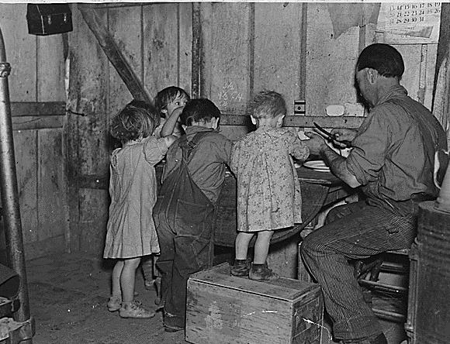
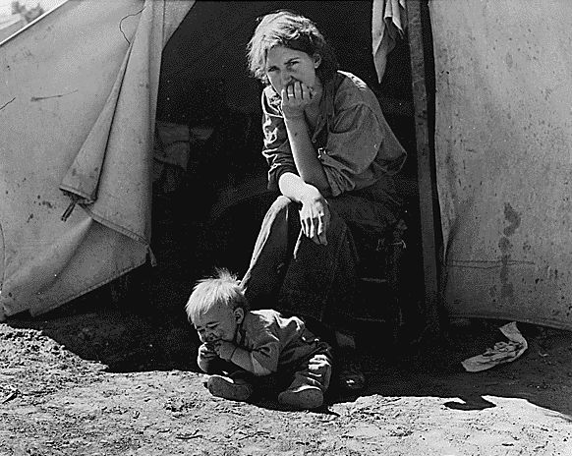
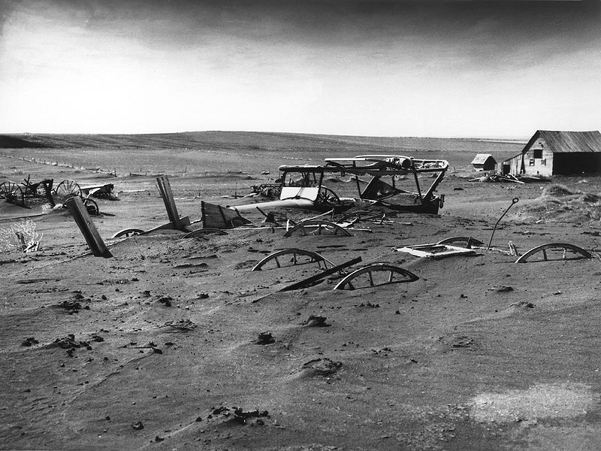
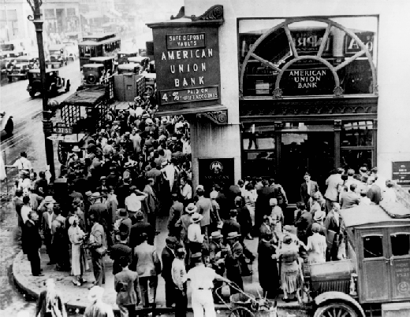


Images of the Depression
Dust Bowl

Slide 3
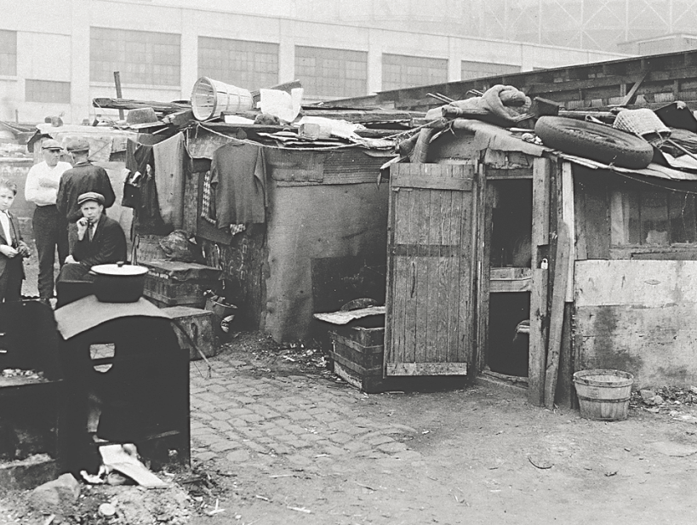
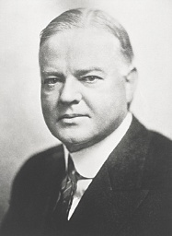
Hoovervilles
Microeconomics was well-developed; macroeconomics was not. The effort to understand economic slumps and find ways to prevent them is at the core of macroeconomics.
During the Great Depression, “Hoovervilles” sprang up across America, named after the economically clueless President Herbert Hoover.

Slide 4

Macroeconomics
Pre-1930s conventional wisdom
Self-regulating economy (Classical): Problems such as unemployment are resolved without government intervention through the working of the invisible hand.
Post-1930s conventional wisdom
Keynesian economics: Economic slumps are caused by inadequate spending, and they can be mitigated by government intervention.
“The long run is a misleading guide to current affairs. In the long run we are all dead”.
Economists set themselves too easy, too useless a task if in tempestuous seasons they can only tell us that when the storm is past the ocean is flat again.”
John Maynard Keynes, A Tract on Monetary Reform (1923)

Slide 5
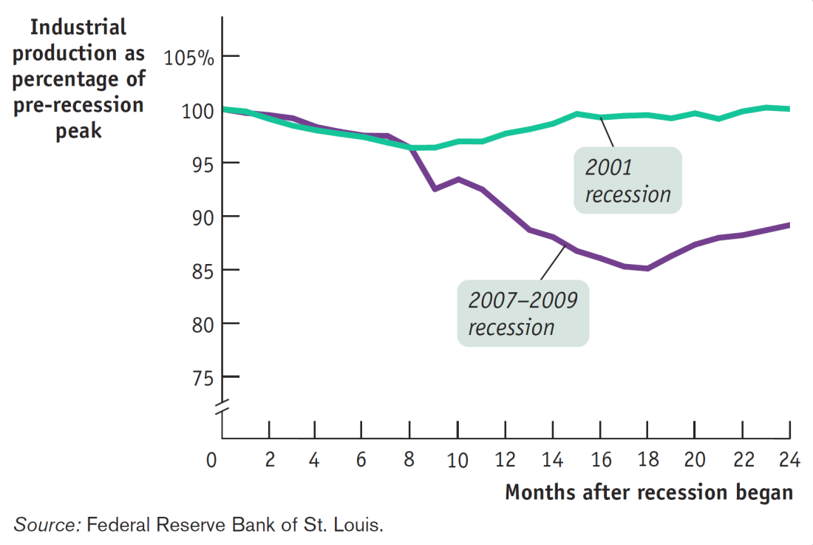
Not All Recessions Are Created Equal
The 2001 recession was milder than the 2007–2009 one.

Slide 6
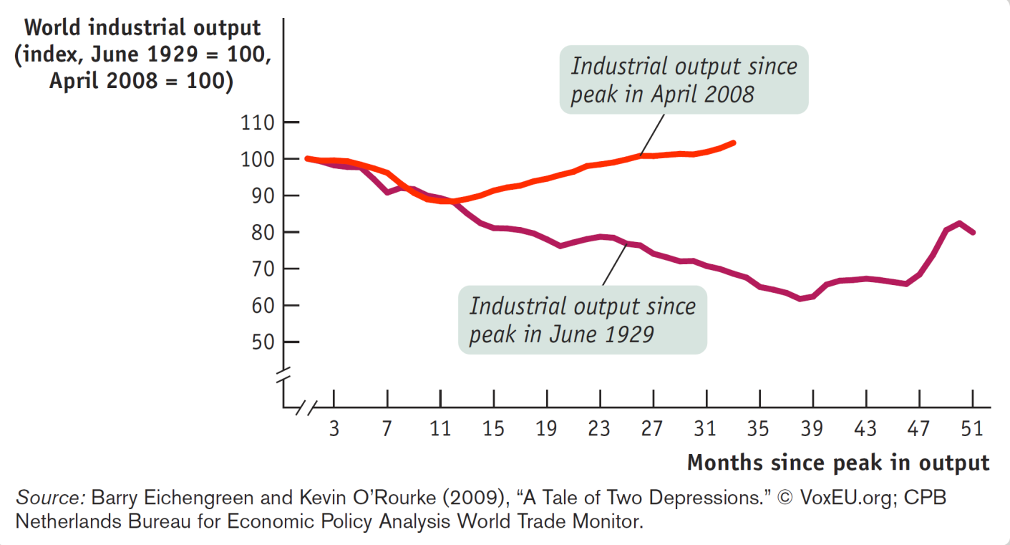
Comparing the Great Recession to the Great Depression
Measures of economic activity and world industrial production during the Great Depression and the Great Recession

Slide 7
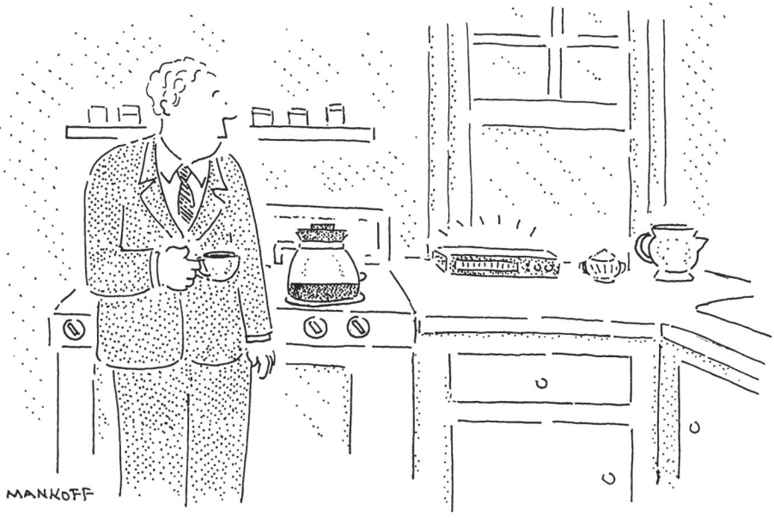
Charting the Business Cycle
“Please stand by for a series of tones. The first indicates the official end of the recession; the second, prosperity; and the third, the return of the recession.”

Slide 8
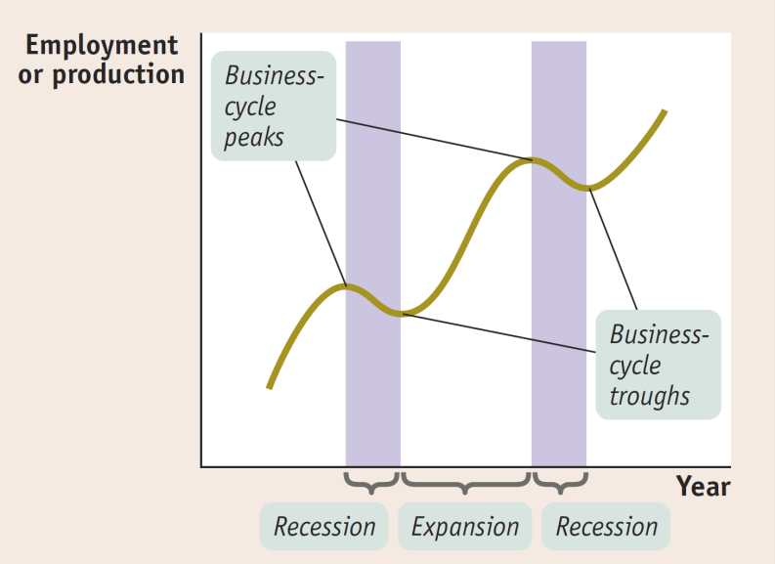
The Business Cycle
The point at which the economy turns from expansion to recession is a business-cycle peak.
The point at which the economy turns from recession to expansion is a business-cycle trough. (not: through)

Slide 9
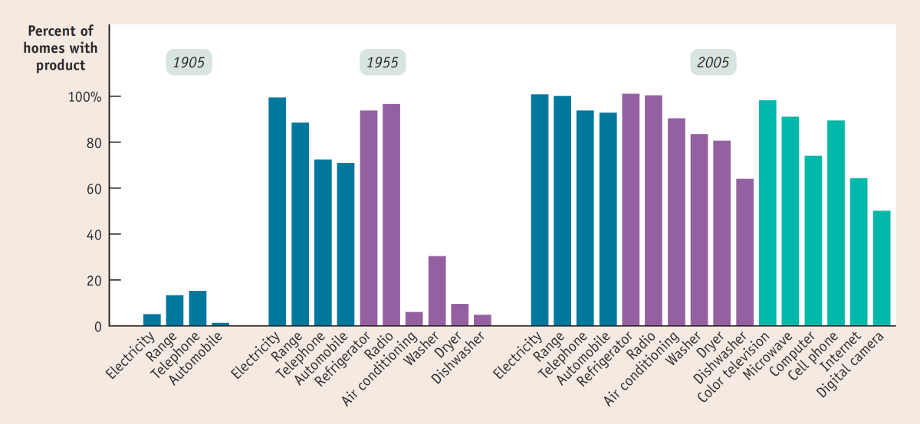
Long-Run Economic Growth
Long-run economic growth is the sustained upward trend in the economy’s output over time.
Source: W. Michael Cox and Richard Alm, “How Are We Doing?” The American (July/August 2008). http://www.american.com/ archive/2008/july-august-magazine-contents/how-are-we-doing

Slide 10
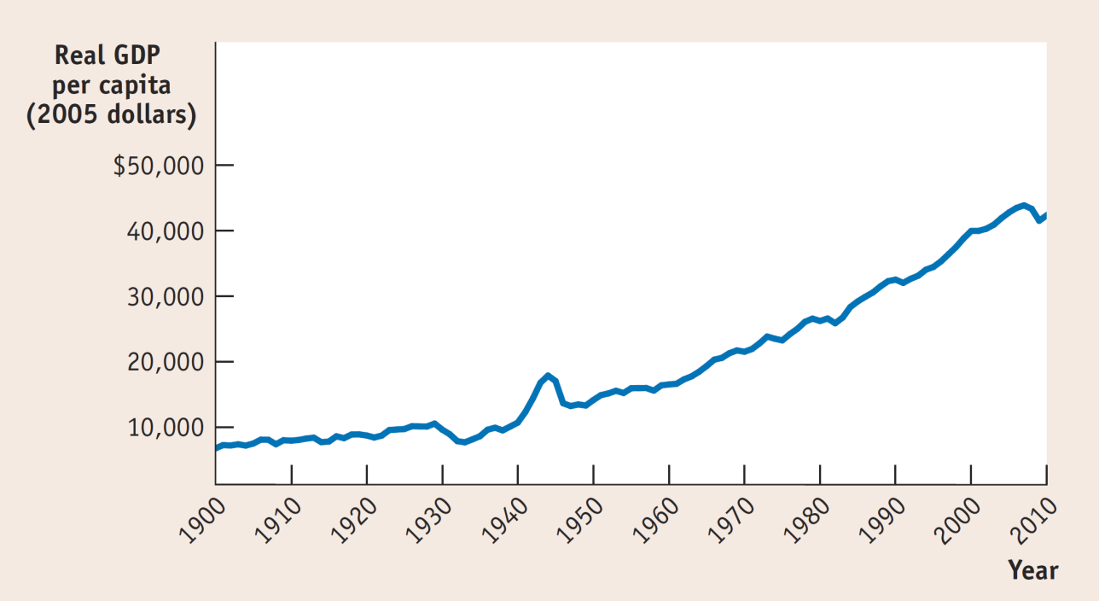
Growth, the Long View
Americans have become able to afford many more material goods over time thanks to long-run economic growth.
Sources: Angus Maddison, Statisticson World Population, GDP, and Per Capita GDP, 1–2008AD,http://www.ggdc.net/MADDISON/oriindex.htm; Bureau of Economic Analysis.

Slide 11

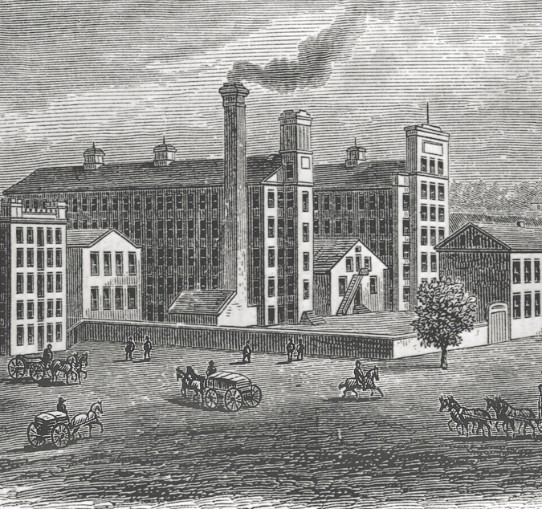
Growth, the Long View

Slide 12
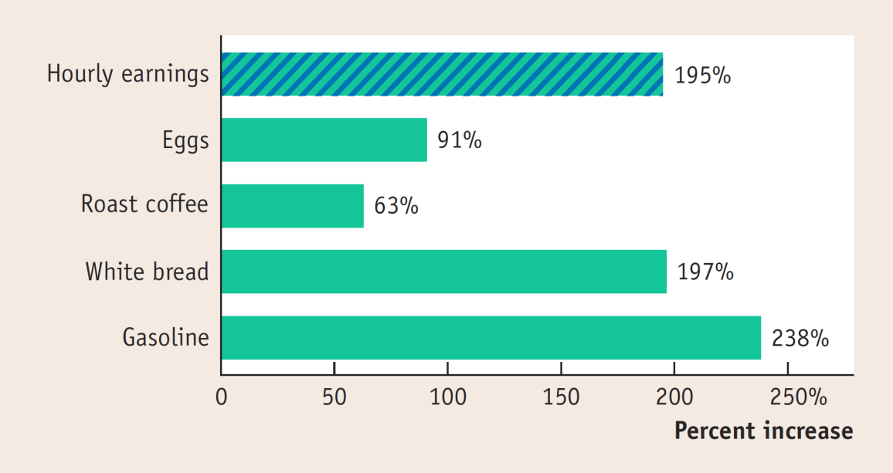
Inflation and Deflation
A rising overall level of prices is inflation.
A falling overall level of prices is deflation.
The economy has price stability when the overall level of prices changes slowly (or the same pace with the growth).
Rising Prices offset most of the rise in average wages.
Source: Bureau of Labor Statistics

Slide 13
US Government
Federal Government
Expenditures:
Social Security Benefits, Medicare, Medicaid, Defense and Security, interests on National Debt
Revenues:
Personal Income Taxes, Corporate Income Taxes,
Social Security Taxes
State and Local Government:
Expenditures: Education, Highways, Public Welfare benefits
Revenues: Sales Taxes, Corporate income taxes, Transfers from Federal government, Property Taxes, Individual income taxes
Budget Deficit and National Debt
Expenditures > Revenues
Accumulated Deficit == DEBT

Slide 14
Growth & Production
What do we produce?
Consumption goods, Capital goods, Government goods/services, Export goods/services
How do we produce?
Land, Labor, Capital, Entrepreneurship
Rent, Wages, Interest, Profit/Loss
The Global Economy
Advanced Economies, Emerging Market, Developing Economies
Differences in what is produced
Human Capital Differences
Physical Capital Differences
Economic Growth and Happiness

Slide 15

You might not understand everything mentioned in this epic economist rap battle YET…but you will enjoy it and get a taste for the philosophical debates about stabilization policy within macroeconomics. (6:28 minutes)
Notes:
http://econstories.tv/2010/06/22/fear-the-boom-and-bust/

